Slide 1
Media Representation Through Time Magazine Faces
Sharon Kim

Slide 2
Introduction
Goal
Determine how representation in media has changed over the past 100 years
Facial Feature Analysis
Mean-Face (Average Face) Analysis

Slide 3
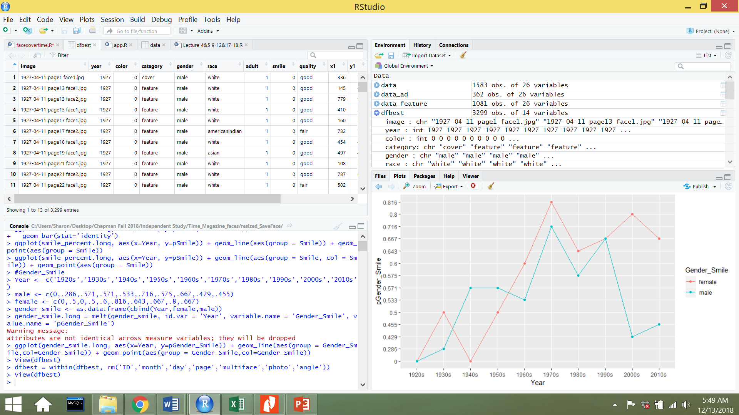
Data Pre-Processing
MTurk (Human Workers)
Manually extracted/cropped out each photo
Manually labeled each photo
Gender
Male
Female
Category
Cover
Feature
Ad
Author
Etc.

Slide 4
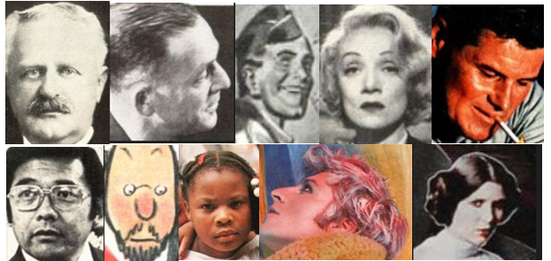
Sample of Images
Images varied in size
Varied in position of face
Faces were not aligned with one another

Slide 5
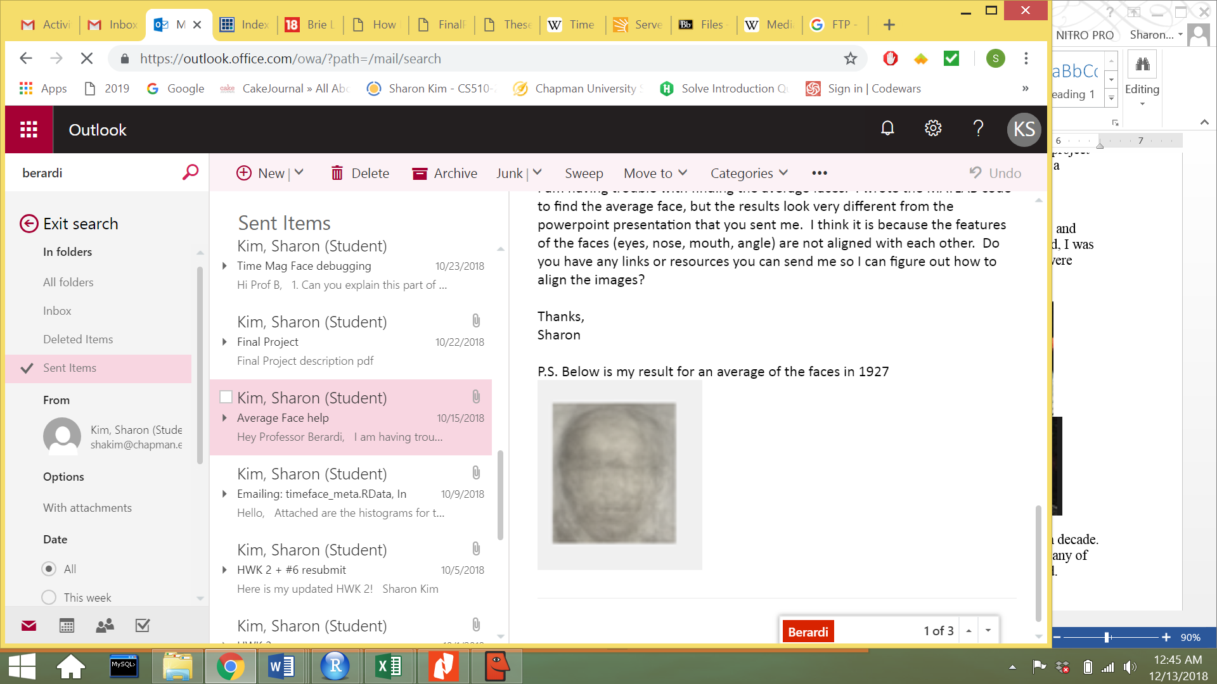
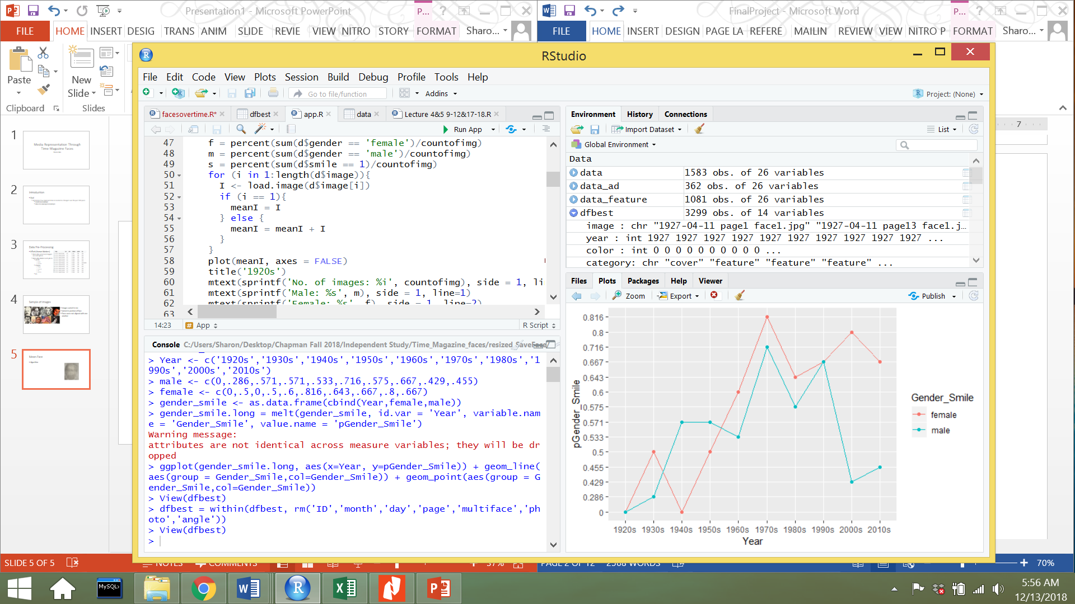
Mean-Face
Algorithm
R Studio Imager library
Sum images together, output is mean image

Slide 6

OpenCV
Used already built facial detection algorithm that was pre-trained
Filtered through images that had side profiles
Aligned all images

Slide 7
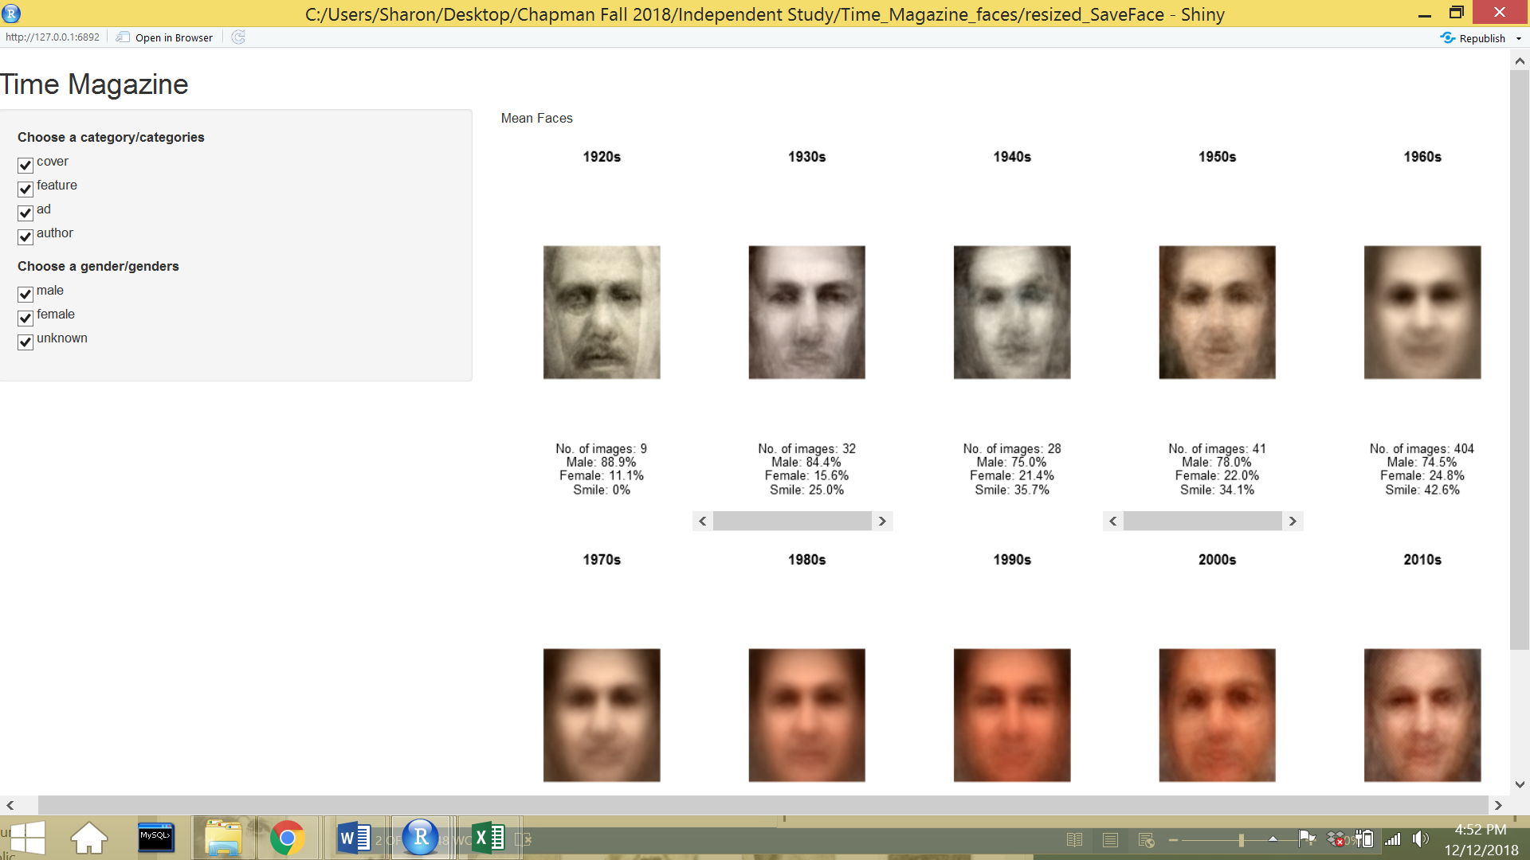
Mean-Face
Began with 4777 images
After face alignment algorithm: 1946 images
Check for data with labels: 1583 images
Final dataset: 1583 images with labeled features

Slide 8
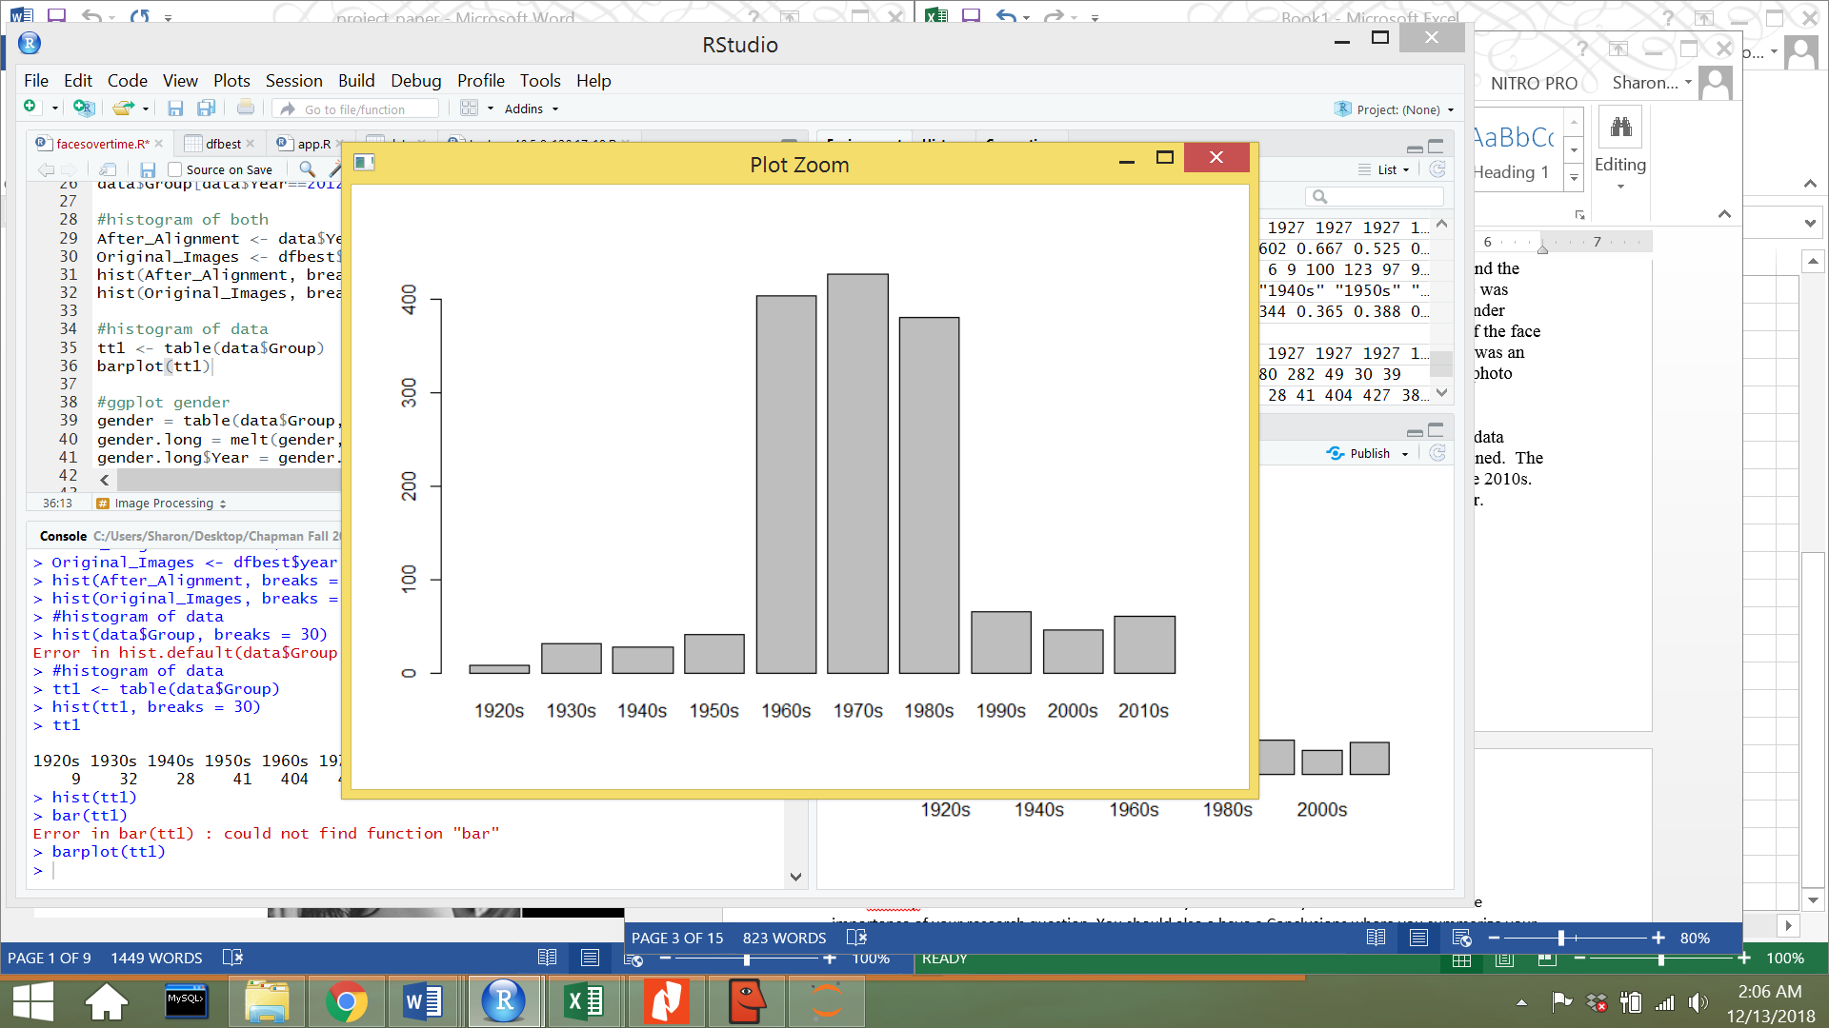
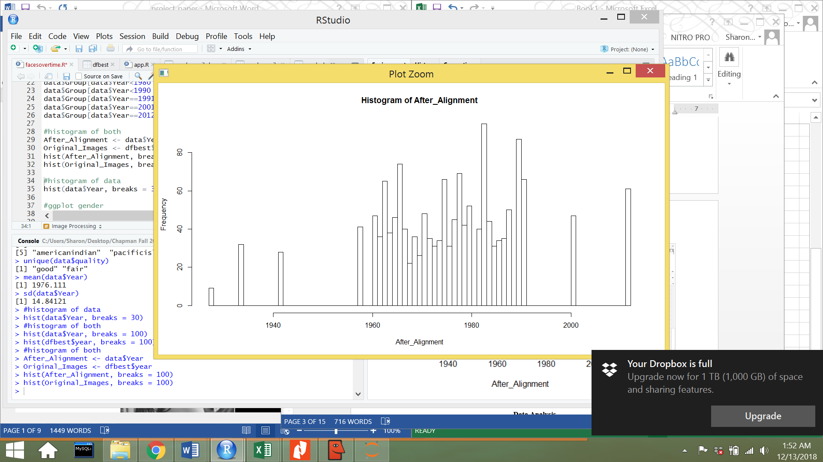
Distribution of the Data
Majority of the data range from 1960s to 1970s
Grouped data by decades

Slide 9
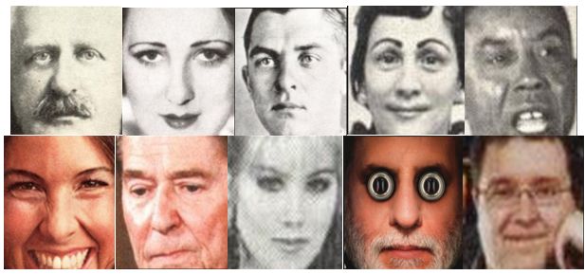
Sample of Images after Pre-Processing

Slide 10
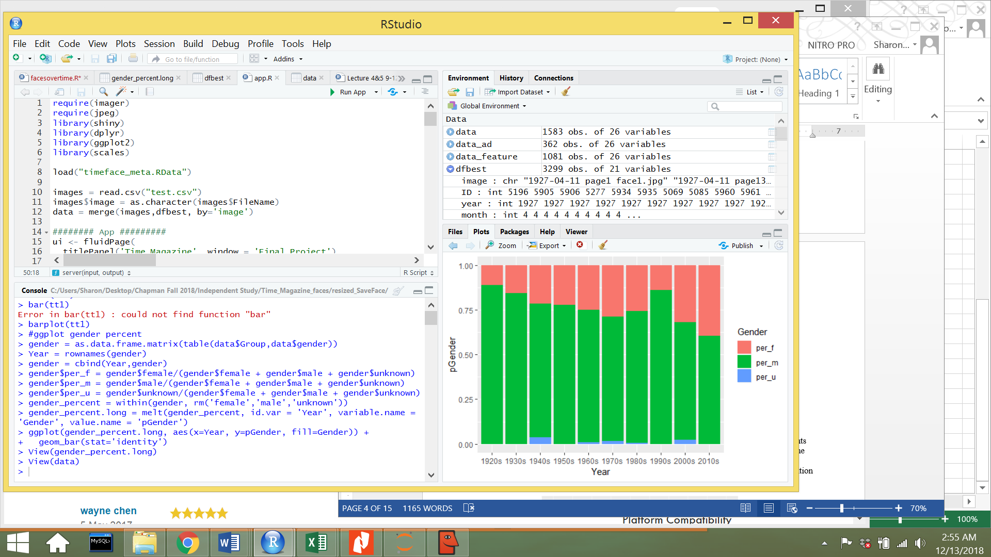
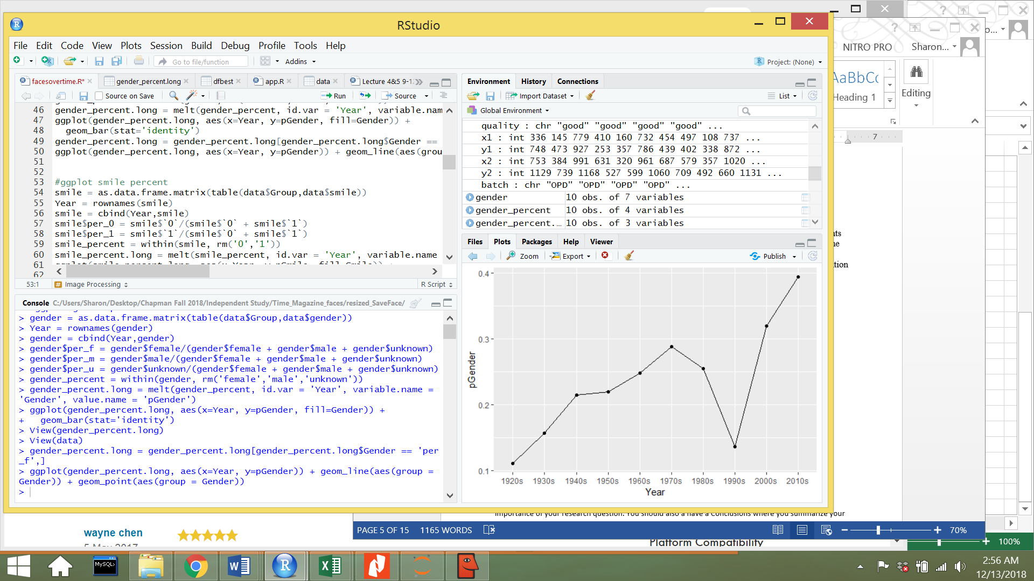
Category: All
Gender
1920s: 11% female
2010s: 39% female

Slide 11
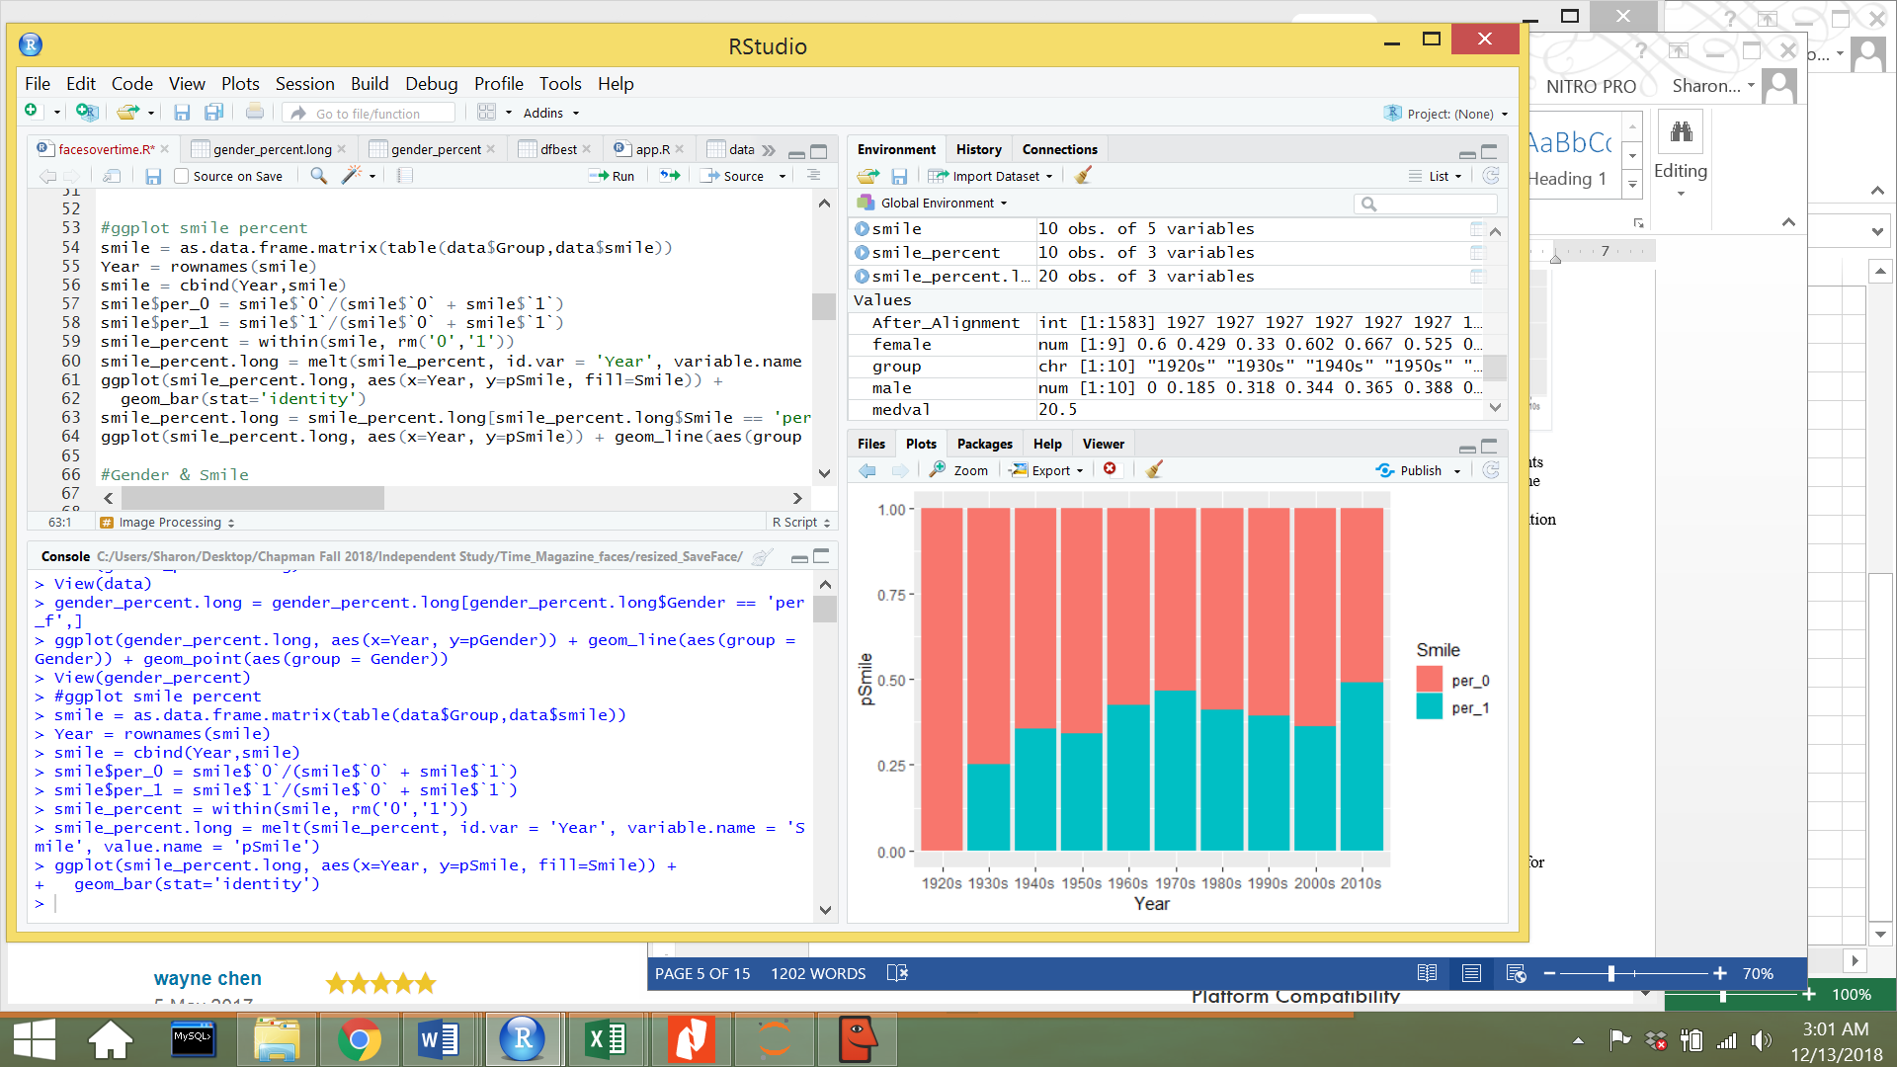
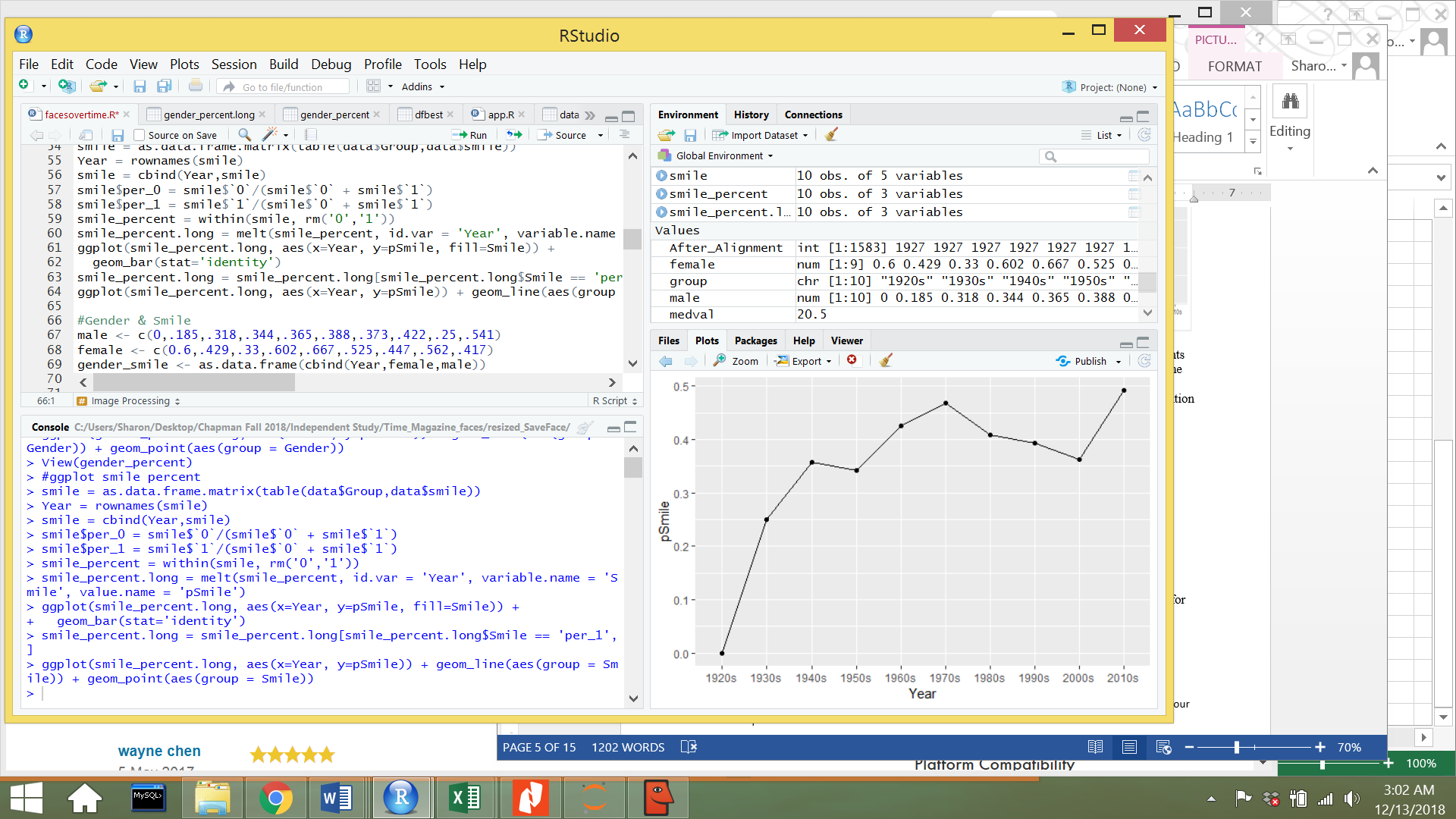
Category: All
Smile
1920s: 0%
2010s: 49%

Slide 12
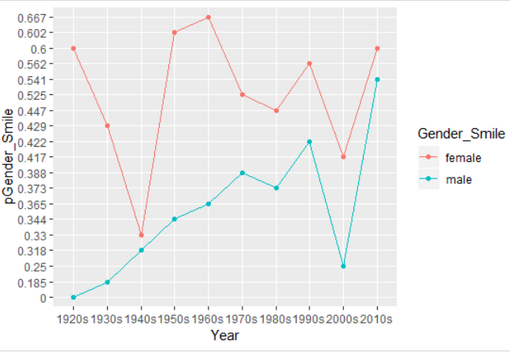
Category: All
Females -> Smiling %
50-60% over time
Males -> Smiling %
1920s: 0%
2010s: 54%

Slide 13
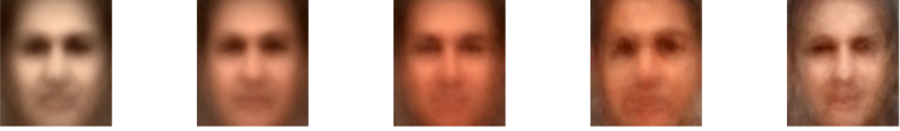
Category: All
Shows gradual smiling over time
Shows more feminine facial features over time

Slide 14
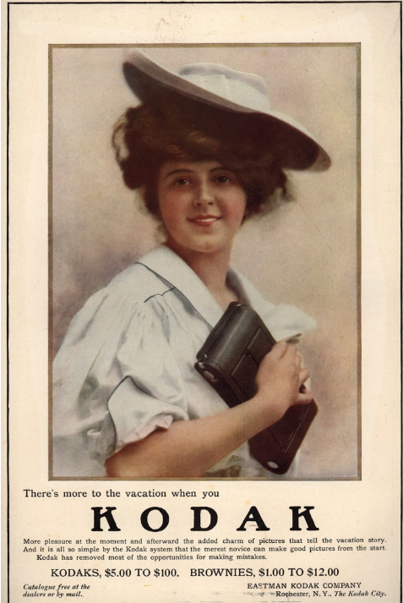
Conclusion/Application
History of Smiling
Innovation of Cameras
Longer exposure time: neutral expression is easier to hold than a smile
Beauty Standards
Small mouths
Fine Art
Peasants, drunkards, children smiling
Kodak & Marketing Campaigns
Normalize taking photos
Portray fun in taking photos
Cheerful stories about products in advertising

Slide 15
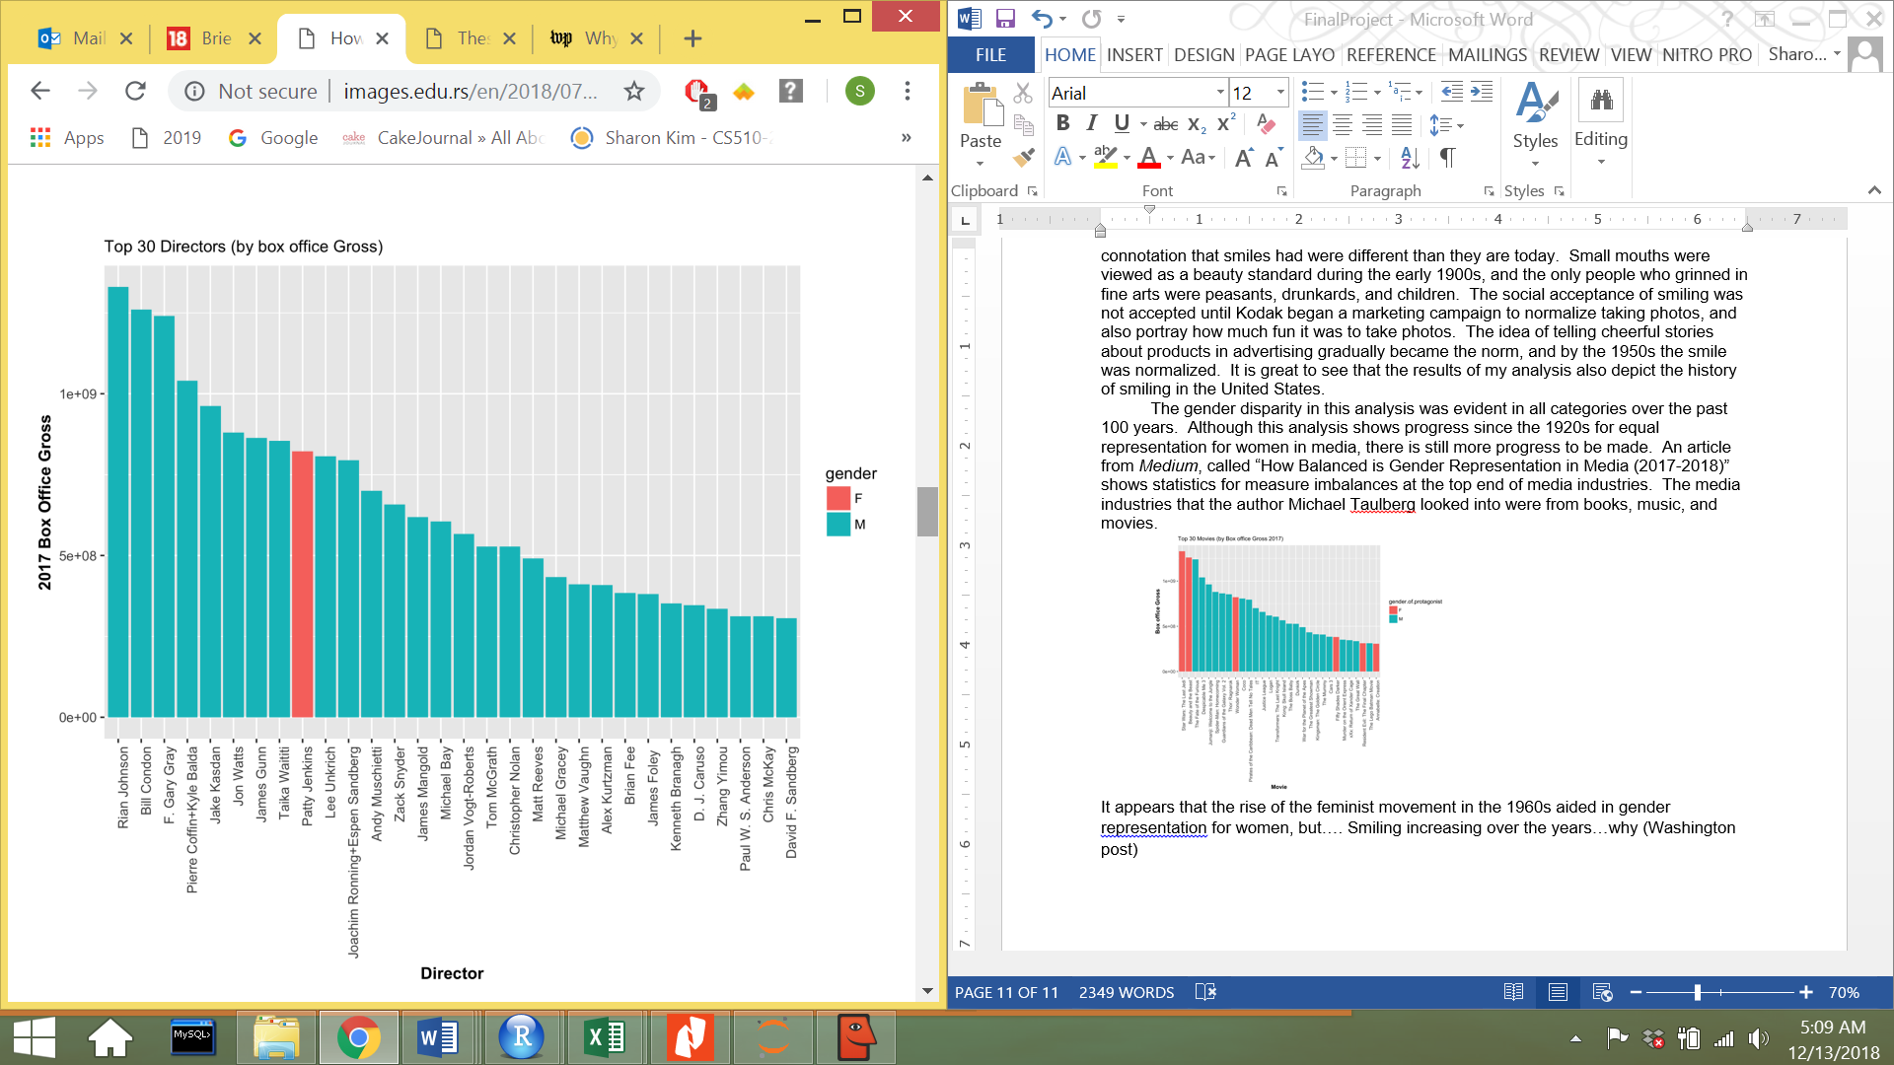
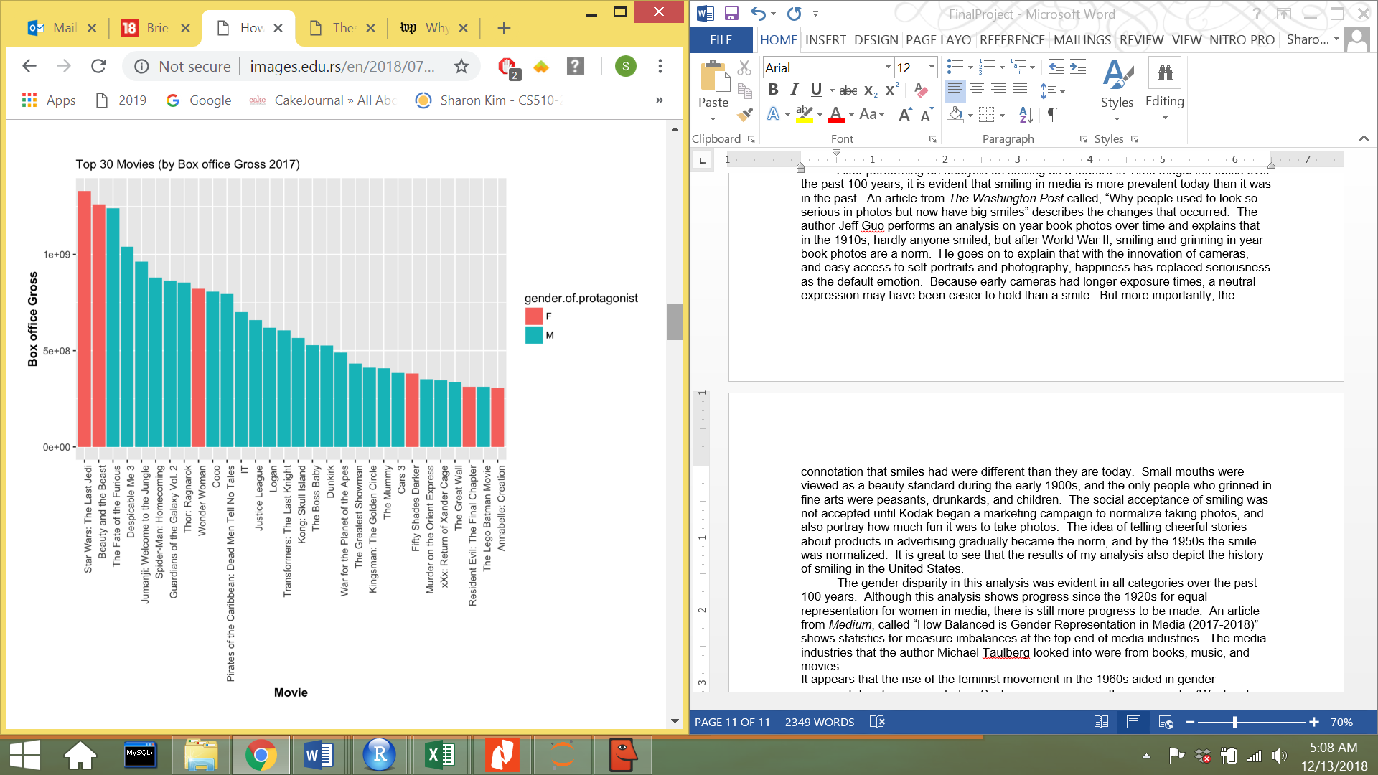
Conclusion/Application
Gender Disparity is Evident today in 2018
We have come a long way, but there is still more progress to be made

Slide 16
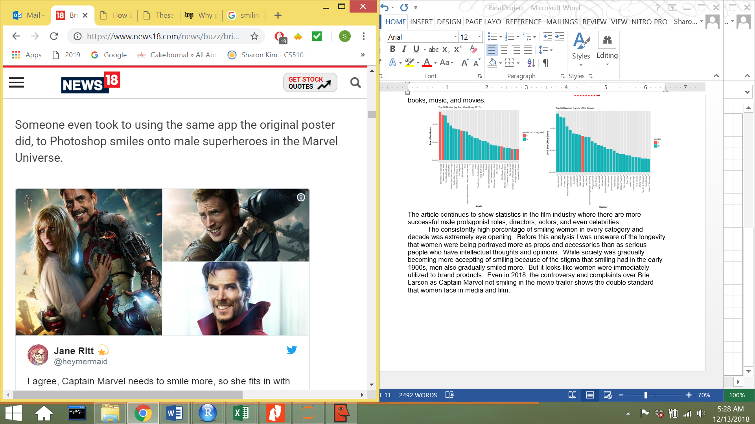
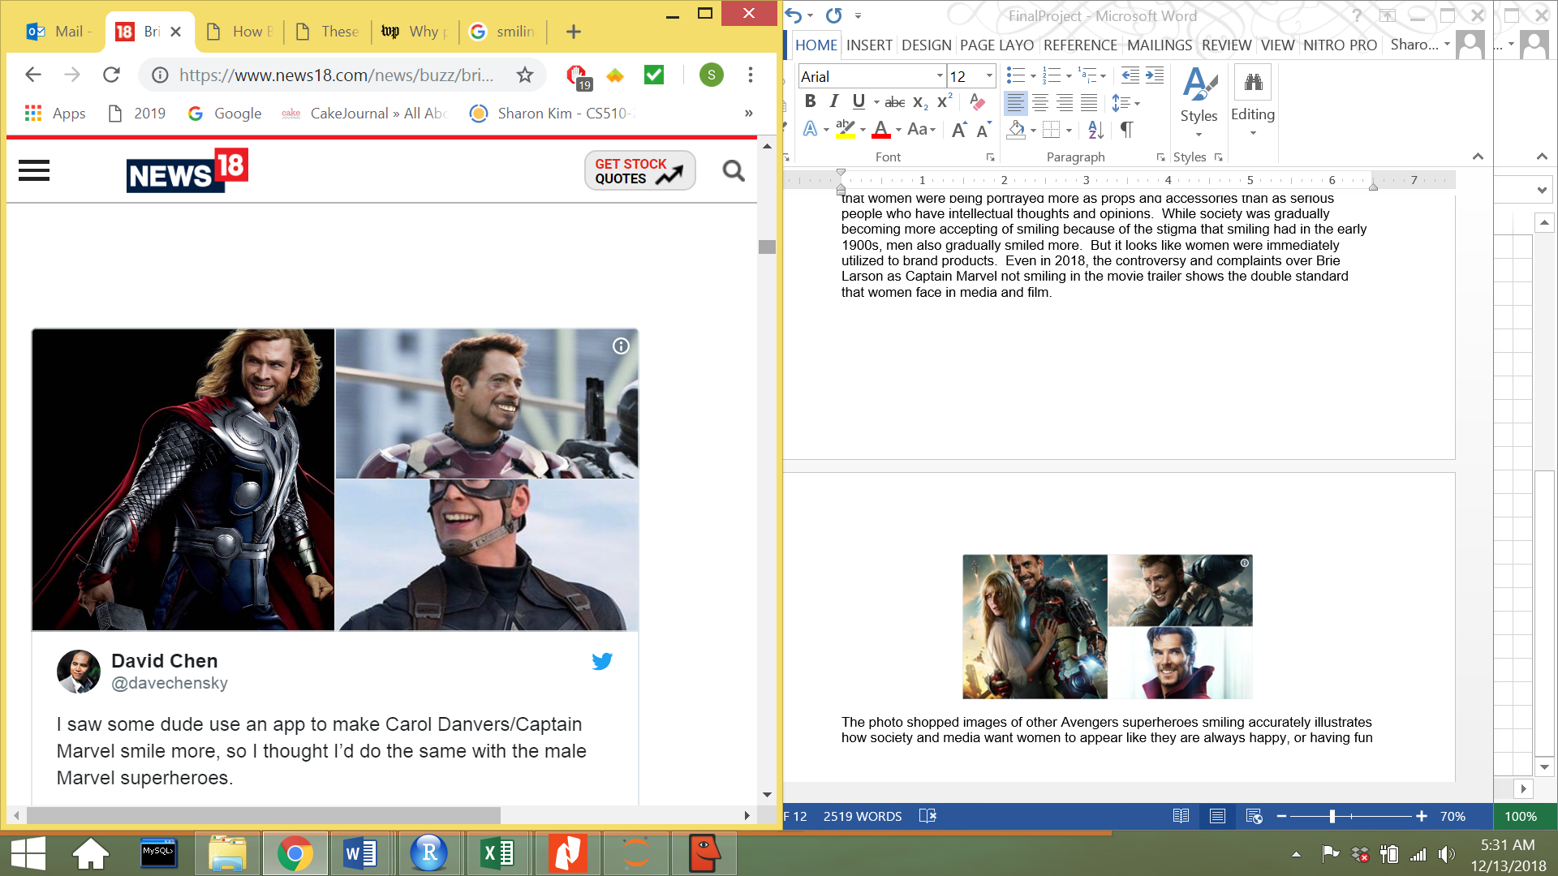
Conclusion/Application
Women & Smiling
Long History & Social Stigma
Captain Marvel Trailer
Complaints that Brie Larson should smile more

